Slide 1
Carmel Henshall c.henshall@ljmu.ac.uk Twitter@carmelhenshall
Adverse Childhood Experiences (ACEs)
Welcome to LJMU annual conference
Notes:
e.g. a child living in a household with violence and addiction, you never blame- complex phenomenon the child – we need to listen to the mothers story, support and nurture the family before progress can be made with children –physco education – most people find it empowering to tell their story – need numbers !!!! Whats wrong with you ??

Slide 2
Brief reminder of the 10 adverse childhood experiences in original study
(Felleti & Anda 1998)
Evidence linking the number of adverse childhood experiences and the adoption of health risk behaviours; and later emotional and physical ill health (*dose response). Individuals may get stuck in ‘survival mode’ / learn to supress feelings unhelpful coping mechanisms such as drugs / alcohol / food to feel ‘ok’ in the world. Long term biological factors of toxic stress; may feel ‘ready to be hurt’
Notes:
Seminal ACES study, published in 1988, has taken 20 years to reach public awareness
Key investigators were vincent felitti (kaiser permanante) and robert anda (center for disease control and prevention). Feletti in particular trying to work out why many people, when successfully losing weight during programme for morbidly obese adults – dropped out of the program and put weight back on. Basically – the better they did, the more likely they were to drop out. He consistently found that this group had histories of childhood trauma with sexual abuse in particular highlighted for this group. The weight for them was a way of coping – protecting and comforting themselves. Obesity provided hidden benefits.
Feletti’s findings formed the basis of the ACES study – survey research of 17k adults – who were asked whether they had experienced any of these 10 ACES under the age of 18

Slide 3
Chronic /toxic stress from ACEs over-develop ‘life-preserving’ part of the brain (Bellis 2020)
The impact of ACEs on brain development

Slide 4
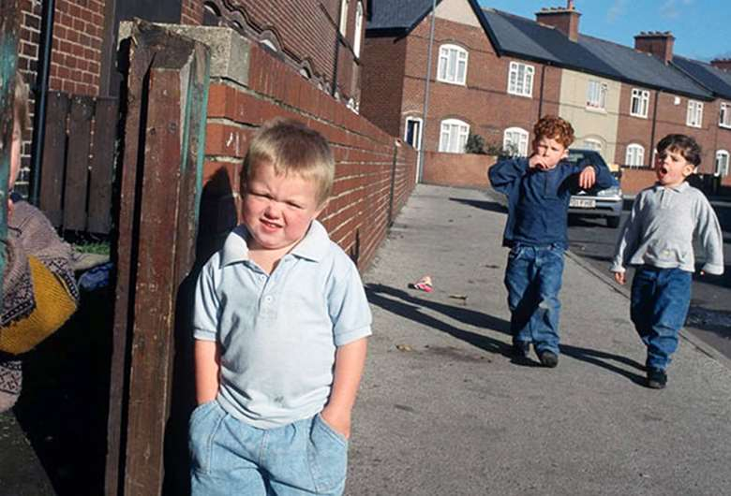
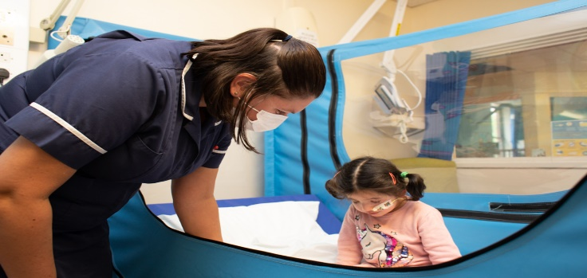
Research was conducted over 20 years ago, toxic stress:
Notes:
Shonkoff neurons to neighbourhoods 2000 – unacceptable gap between what science tells us about early development and what services are doing to support children
Nature versus nurture debate is dead. There’s no such thing as nature without nurture or nurture without nature. A large part of development is influenced by the contexts in which children live. Compelling neuroscience that shows us that the relationships and interactions that go with those relationship, and the feelings that go with those relationships actually influence the emerging architecture of the brain.

Slide 5
Early Infant Foundation (2020)
A focus on the original 10 ACEs to the exclusion of other factors, risks missing people who also need help
No quick fix – ACE’s do not occur in isolation
Policy's needed to address structural inequalities / poverty / community capacity / early intervention (33 recommendations).
Strong professional workforces, who are equipped to meet the needs of children and families struggling with adversity ….as well as the time necessary to establish positive relationships with families (page 5).

Slide 6
Prevention - one sensitive care giver builds resilience when adversity present in the household
Notes:
Worst in the world **************Can grow up to be fine

Slide 7
To conclude
Relationships heal relationships

