Slide 1
Offending or Defending?
presented by Emma White- Senior Mental Health Practitioner- AlderHey CAMHS

Slide 2
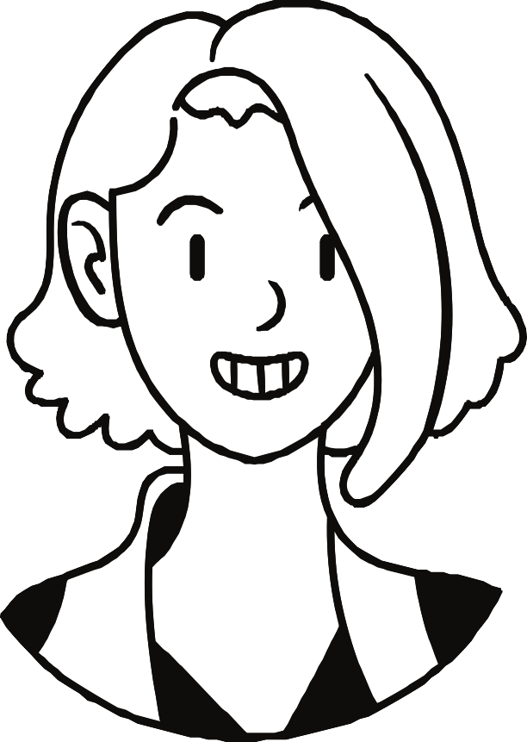
Maggie
Allow me to introduce myself:
15 years old Arrested for PWITS
Assault of a police officer
Thoughts?

Slide 3
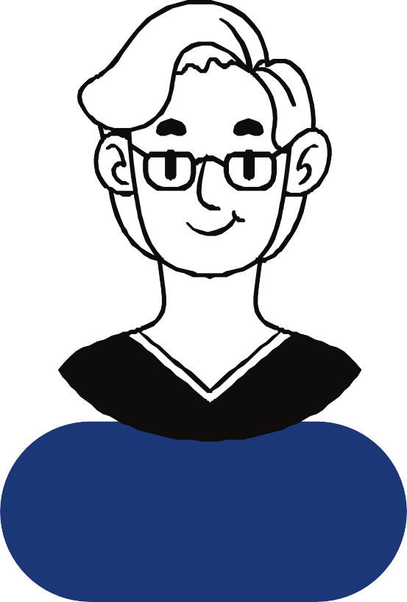
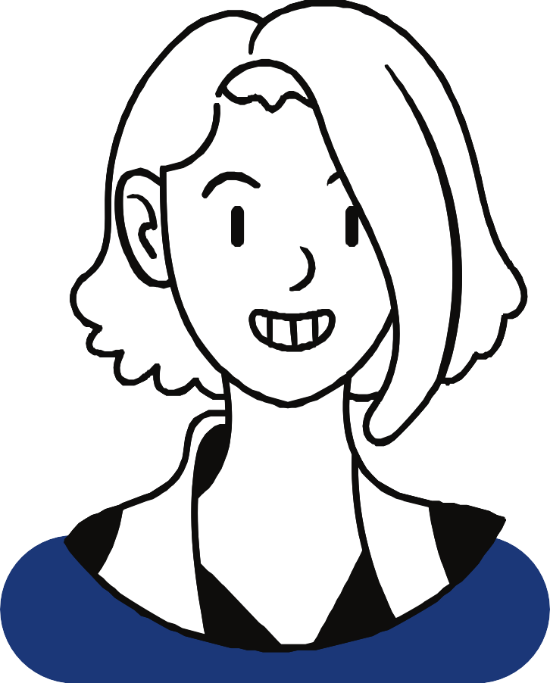
Tell me about you...
You'll need an appropriate adult for your interview, should we call your mum?...
Custody
CJLT
practitoner
Custody Sgt

Slide 4
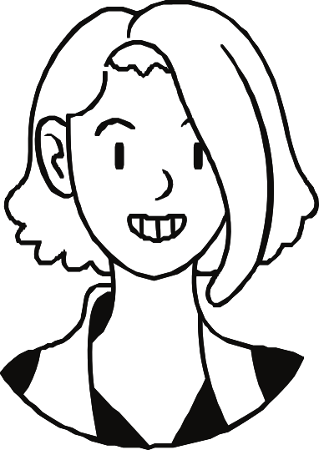
Layers of understanding/ formulation
Offending history
Separation/loss of a parent
parental substance misuse
Parental criminality

Slide 5
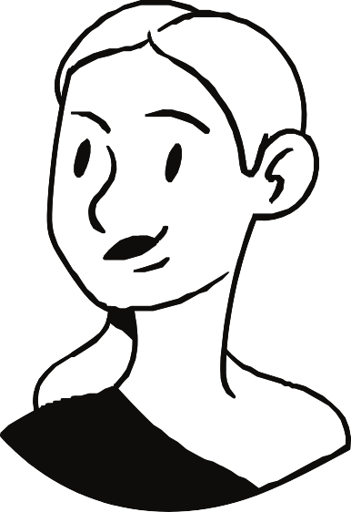
Youth Offending Service
You'll need to come to see me once a week to complete some offence focussed work
How else might we view this? What else is important to consider?
CAMHS YOS
practitioner
Custody Sgt

Slide 6
Layers of understanding/ formulation
Parental mental health
Separation/loss of a parent
Unexplained financies
Physical abuse
parental substance misuse
Parental criminality
Offending history
Witnessed domestic violence

Slide 7
Layers of understanding/ formulation

Slide 8
Remain Curious!
Awareness of the power imbalance
Context is key

Slide 9
Thank you
I really appreciate your time.

