Slide 1
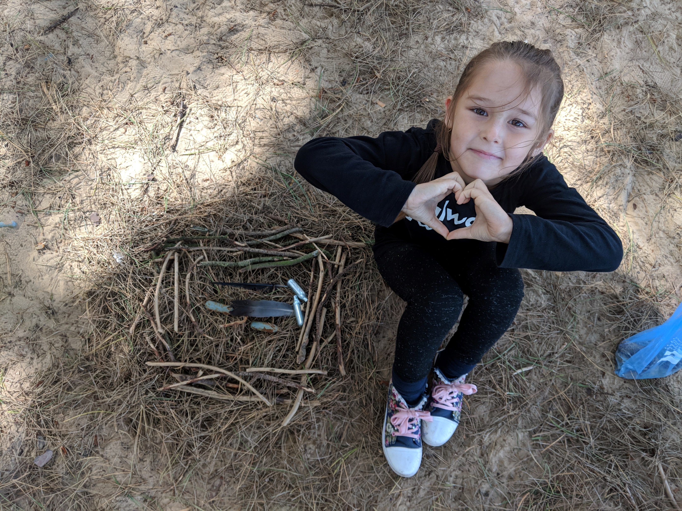
LIVERPOOL

Slide 2
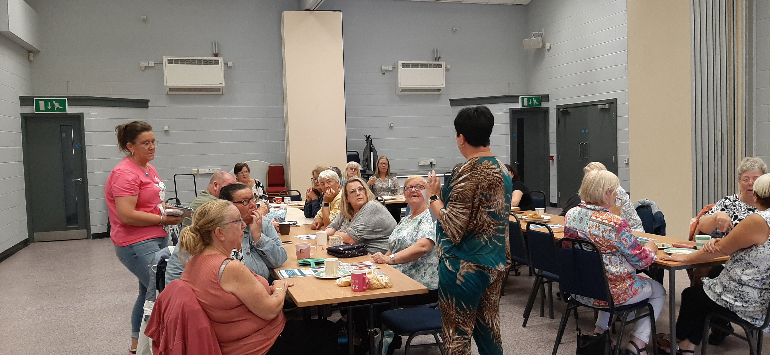
History
1980s PADA – NATURALLY DEVELOPED
REGISTERED CHARITY
PROJECTS DELIVERED DEPENDING ON FAMILIES NEEDS
FUNDERS THAT ENABLE US TO BE CREATIVE

Slide 3
What is a Kinship Carer
‘Kinship Care is where a child or young person lives full-time with a relative or family friend because they are not able to live with their birth parents’

Slide 4
Complexities
If the LA was involved in placing this child and without the intervention the child would be in LA Care then the LA have a duty of care to support the placement
Support available to families are often based on how the child came to live with you – two children from same family may have access to different support
Our project supports families depending on needs not on status

Slide 5
ANIMATION

Slide 6
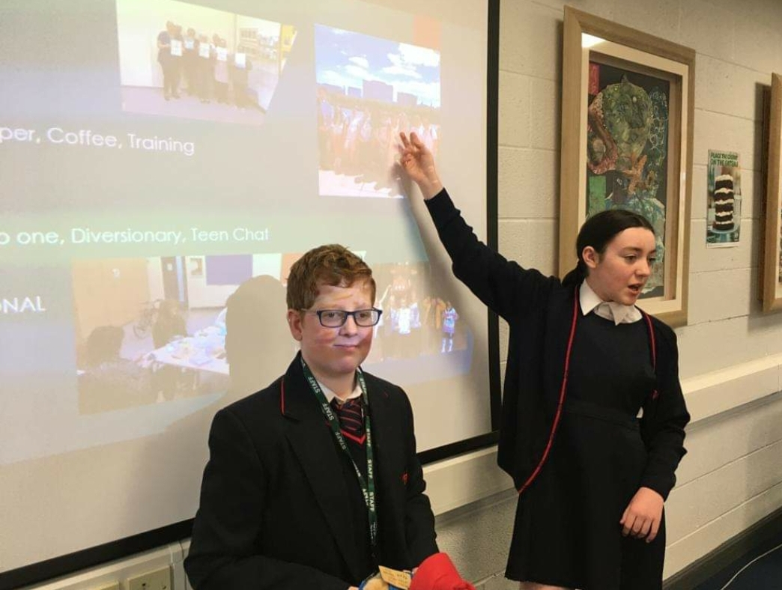
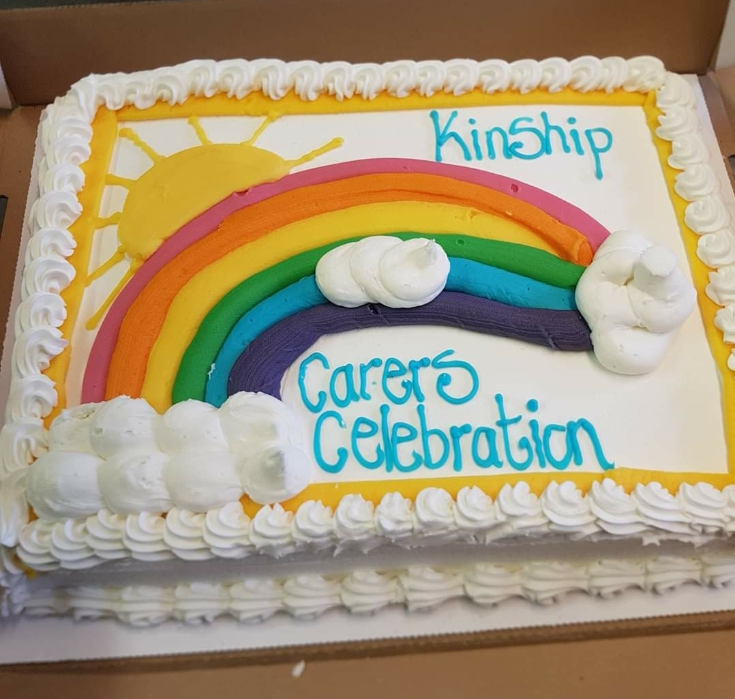
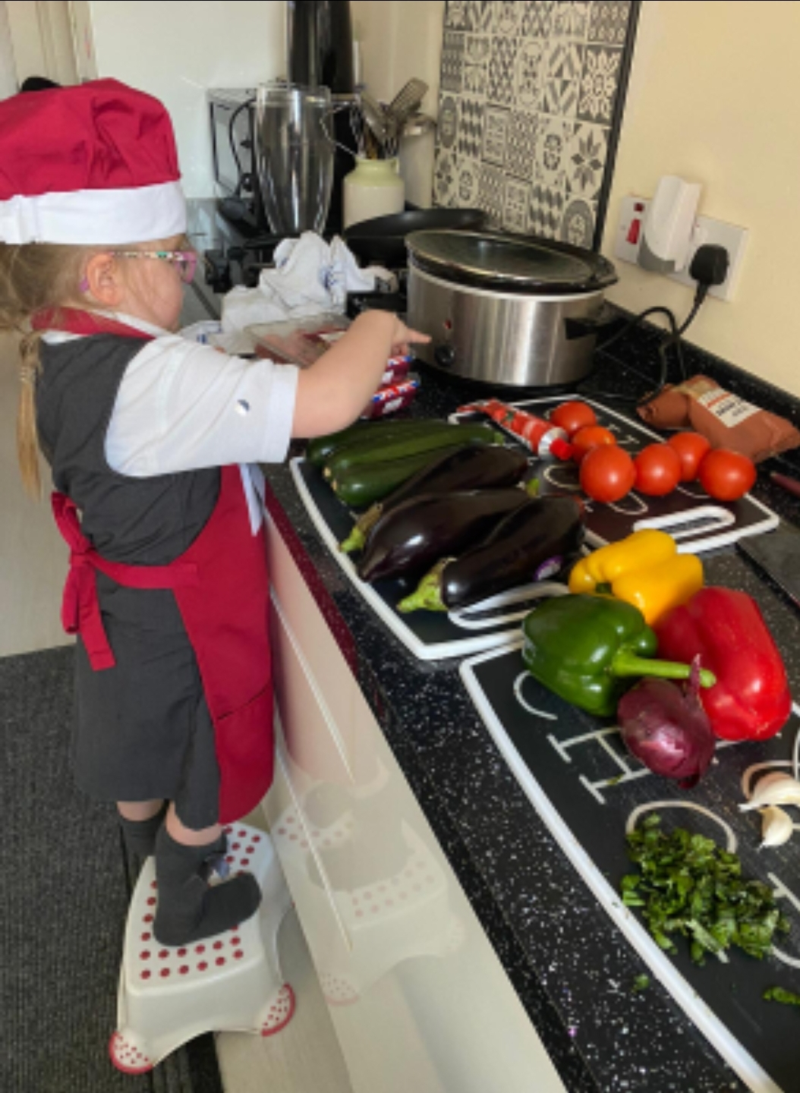
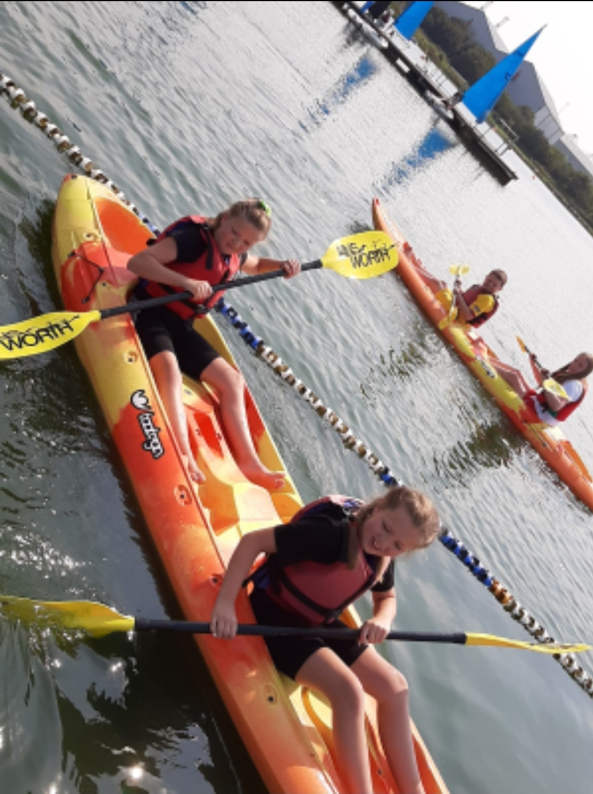
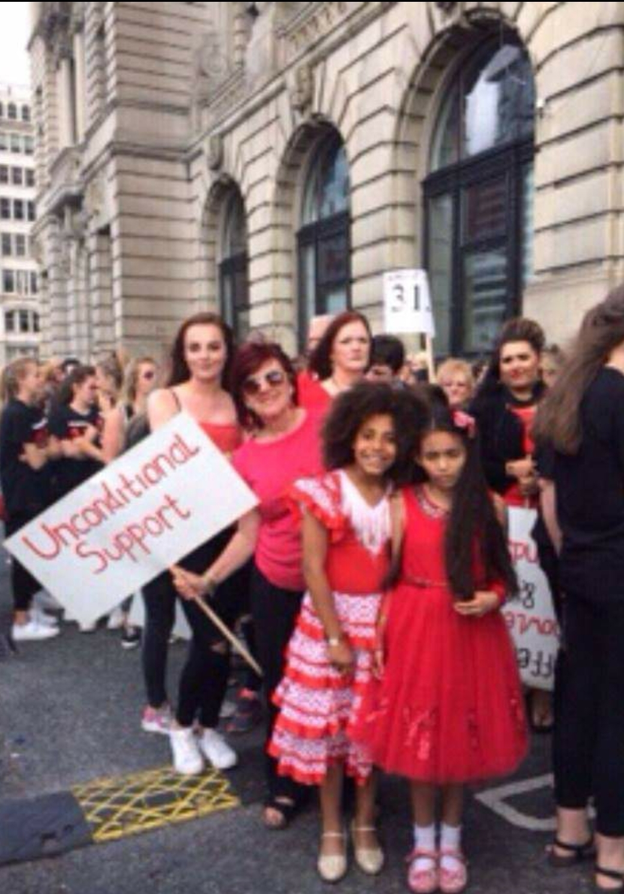
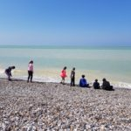
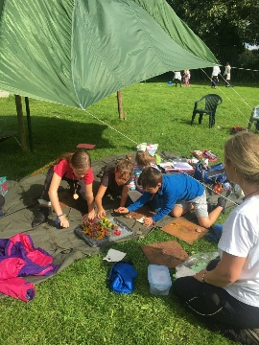
FAMILY SUPPORT
INTERGENERATIONAL
ONE TO ONE
GROUP WORK
CAMPAIGNING FOR CHANGE

Slide 7
CASE STUDY
Amy rarely went to school, she lived with her mum and witnessed her chaotic substance misuse and involvement in crime
At 8 years old she went to live with Nan, at 14 she had two younger siblings who also came to live with Nan
Amy took on a caring role of her siblings amid a still somewhat chaotic household, full of arguments, very little money and ill health
Amy engaged with Kinship Carers project, meeting others with similar life experiences – reducing isolation, stigma and giving her a voice to talk and make sense of her home life
She took part in diversionary activities, having problem free time with her peers and spoke about her fears for the future

Slide 8
Nan attended our Kinship Care parenting program – which looks at how past trauma can impact on your parenting skills
Recognising the need for boundaries, empowering children to develop resilience
Together they worked as a family, attending Intergenerational Activities and creating a network of support around them
Amy now has a stable home life, with her partner and young son and has broken generational Ace’s faced by her family
She is a valued member of our team and regularly speaks to our Kinship Families and professionals about the important role we all have in supporting young people like her

